Slide 1
Emotion Detection From Facial Expressions
Anuj Verma 2017026
Sohaib Fazal 2017267

Slide 2
Dataset
Our Dataset consists of 48*48 images. There are 28,709 training images, followed by 3589 public test images(validation) and 3589 private test images. There were labels; 0 -Angry, 1- Disgust; 2- Fear;3- Happy; 4- Sad; 5- Surprise; 6- Neutral
The training dataset was balanced using SMOTE to give 7215 samples of each. Outliers were also checked using z score of dataset which were none.
Labels | Angry | Disgust | Fear | Happy | Sad | Surprise | Neutral
samples | 3995 | 436 | 4097 | 7215 | 4830 | 3171 | 4965

Slide 3
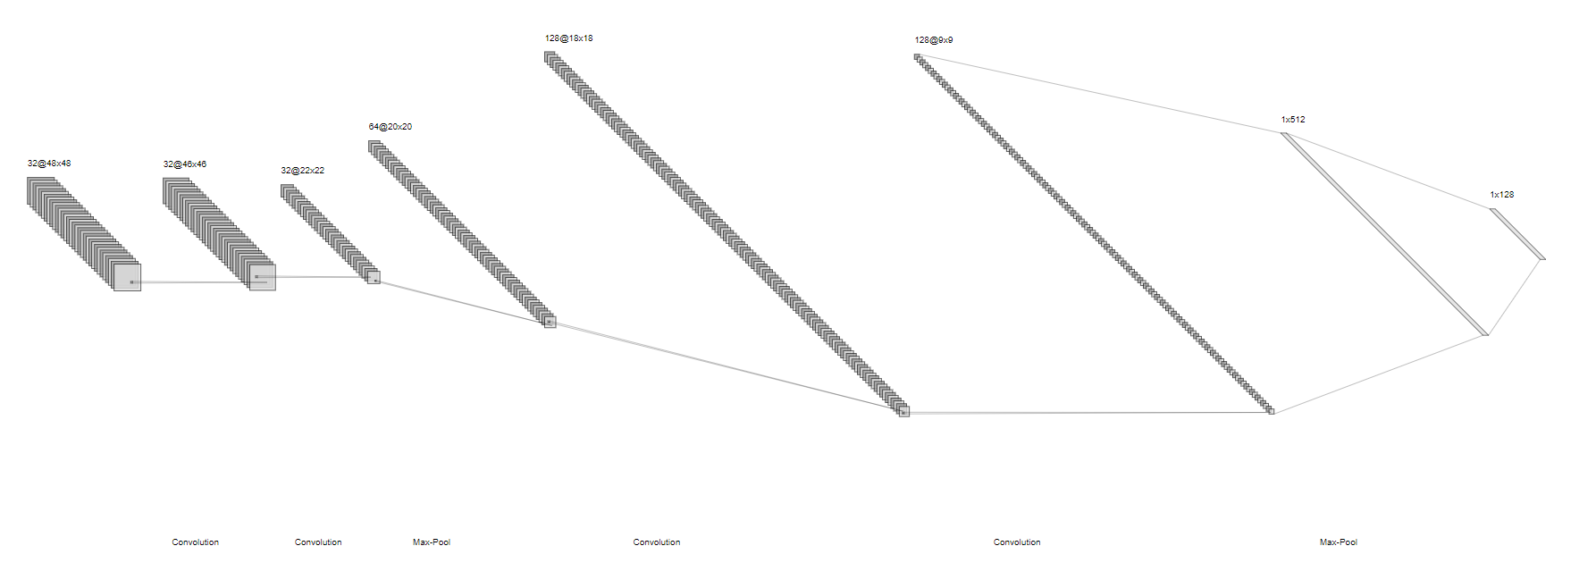
Model
We built a 4 layer convolutional model withsizes 32,32,64,128 respectively. The kernel used is of size (3,3) and max pooling between layers is done of size (2,2). 3 dense layers are added to the model of sizes 128 ,512 and 7 respectively. Activation used is ‘relu’ except last layer where sigmoid is used. A dropout of 0.25 is used except last layer where dropout = 0.5.Also batch normalization was added between each layers to avoid overfitting.

Slide 4
Approach and Accuracy
Our cnn model is trained on 4 types of images - Model 1) Simple images Model; 2) Images added with noise N(0,0.5) ;Model 3) Images first added noise then predicted using autoencoder ;Model 4) Segmented Images From the plots of each models we notice that model2>=Model 1>Model 3>Model 4.
We also plotted the confusion matrix for each model and noticed that emotions Happy, Surprise, Neutral, disgust are well predicted in comparison to angry, fear,sad
Also we found out psnr of some random images given for training to each model and noticed that images with better(higher) psnr were well predicted.
Type | Model1 | Model2 | Model3 | Model4
Train | 0.8793 | 0.7797 | 0.7576 | 0.6809
Testing | 0.6166 | 0.5814 | 0.5486 | 0.4758

Slide 5
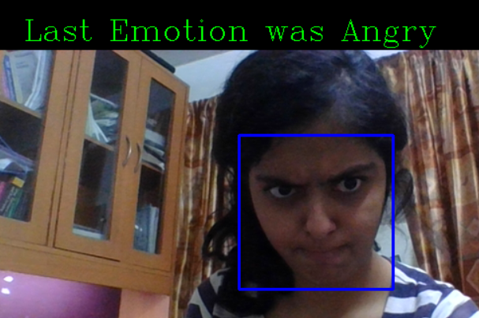
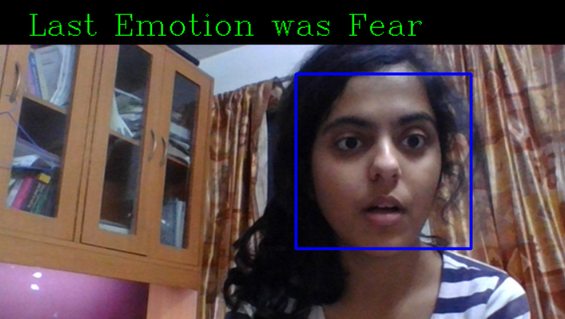
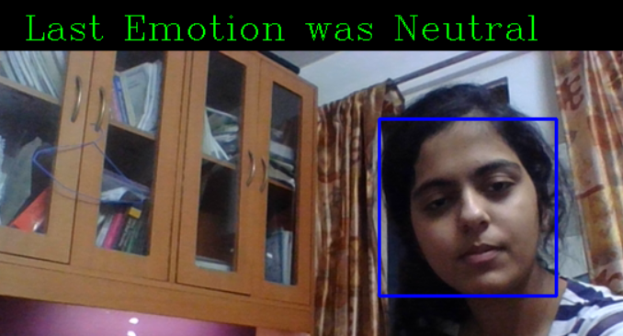

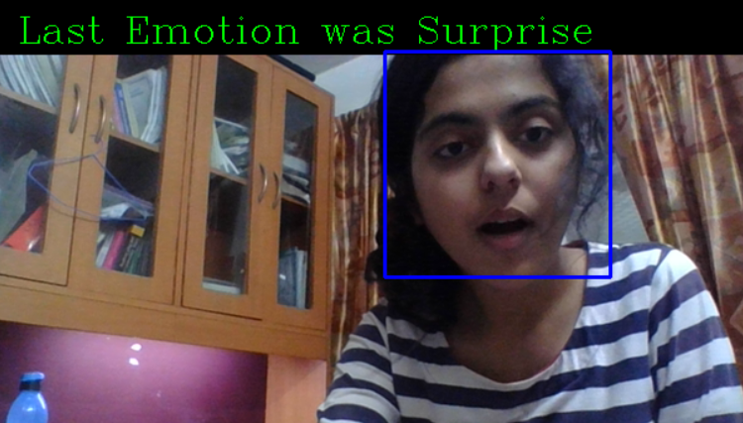
Sample Real Time Prediction

